Slide 1
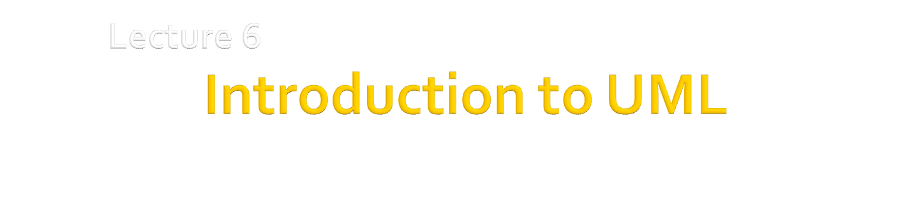
Dr. Hesam Chiniforooshan
se.usc.ac.ir@gmail.com

Slide 2
Outline
Why Modeling
Introduction to UML
History
Super Structure
UML Class Diagram
Notation
Classes vs. Objects
Relationships
UML Activity Diagram
Notation
Partitioning
Action / Control / Object Nodes
2

Slide 3
Getting started
You’ve just joined an ongoing project
Where do you start?
(oh, BTW, the project doesn’t really have any documentation)
Requirements Analysis:
Who uses it? For what?
What are the major entities and systems involved
Reverse Engineering:
Recover design information from the code
Create higher level views to improve understanding
E.g. Structure of the code
Code Dependencies
Components and couplings
E.g. Behaviour of the code
Execution traces
State machines models of complex objects
E.g. Function of the code
What functions does it provide to the user?

Slide 4
Why build models?
Modelling can guide your exploration:
It can help you figure out what questions to ask
It can help to reveal key design decisions
It can help you to uncover problems
e.g. conflicting or infeasible requirements, confusion over terminology, scope, etc
Modelling can help us check our understanding
Reason about the model to understand its consequences
Does it have the properties we expect?
Animate the model to help us visualize/validate the requirements
Modelling can help us communicate
Provides useful abstracts that focus on the point you want to make
…without overwhelming people with detail
Throw-away modelling?
The exercise of modelling is more important than the model itself
Time spent perfecting the models might be time wasted…

Slide 5
Dealing with problem complexity
Abstraction
Ignore detail to see the big picture
Treat objects as the same by ignoring certain differences
(beware: every abstraction involves choice over what is important)
Decomposition
Partition a problem into independent pieces, to study separately
(beware: the parts are rarely independent really)
Projection
Separate different concerns (views) and describe them separately
Different from decomposition as it does not partition the problem space
(beware: different views will be inconsistent most of the time)
Modularization
Choose structures that are stable over time, to localize change
(beware: any structure will make some changes easier and others harder)

Slide 6
the Unified Modelling Language (UML)
Standardized general-purpose modeling language
Used to specify, visualize, construct, and document the design of an object-oriented system under development
Offers a way to visualize various elements of a system such as activities, actors, business processes, database schemas, logical components, programming language statements, and reusable software components.
Combines techniques from data modeling(entity relationship diagrams), business modeling (work flows), object modeling, and component modeling
Booch, Rumbaugh & Jacobson are principal authors
Attempt to standardize the proliferation of OO variants
Is purely a notation
No modelling method associated with it!
Was intended as a design notation
Can be used anywhere in the software development cycle
Has become an industry standard
But is primarily promoted by IBM/Rational (who sell lots of UML tools, services)
Has a standardized meta-model
Use case diagrams , Class diagrams, Message sequence charts, Activity diagrams, State Diagrams , Module Diagrams, …

Slide 7
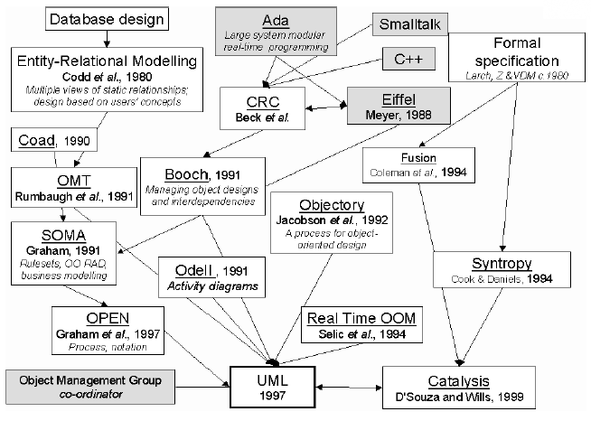
Why is it called Unified ML?
More than 50 modeling languages
were available during early 1990’s
Method War !!
1994: Rational Software Corporation hired Three Amigos:
James Rumbaugh → Object Modeling Technique (OMT), Object Oriented Analysis (OOA)
Grady Booch → Booch method, Object Oriented Design (OOD)
Ivar Jacobson → Object Oriented Software Engineering (OOSE)
1996 UML developed and in 1997 published by OMG

Slide 8
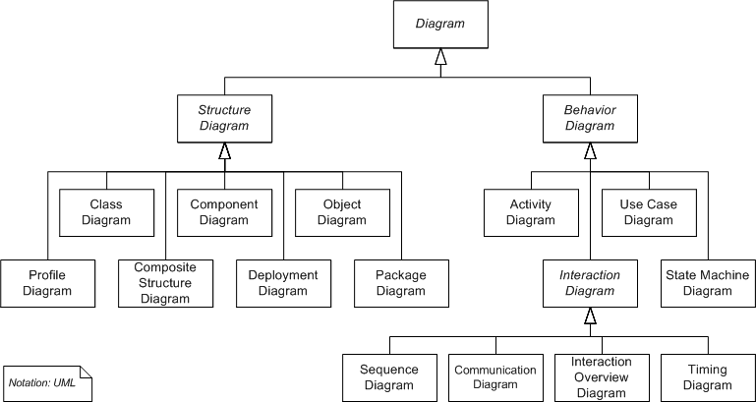
UML2 Diagram Super Structure
Structure Diagram: uses objects, attributes, operations and relationships to emphasize the static structure
Behavior Diagram: shows the collaboration among objects and changes to the internal states of objects to emphasize dynamic behaviour

Slide 9
Modeling Notations
UML Class Diagrams information structure relationships between data items modular structure for the system | Use Cases user’s view Lists functions visual overview of the main requirements
UML Package Diagrams Overall architecture Dependencies between components | (UML) Statecharts responses to events dynamic behavior event ordering, reachability, deadlock, etc
UML Sequence Diagrams individual scenario interactions between users and system Sequence of messages | Activity diagrams business processes; concurrency and synchronization; dependencies between tasks;

Slide 10
Outline
Why Modeling
Introduction to UML
History
Super Structure
UML Class Diagram
Notation
Classes vs. Objects
Relationships
UML Activity Diagram
Notation
Partitioning
Action / Control / Object Nodes

Slide 11
What are classes?
A class describes a group of objects with
similar properties (attributes),
common behaviour (operations),
common relationships to other objects,
and common meaning (“semantics”).
Examples
employee: has a name, employee# and department; an employee is hired, and fired; an employee works in one or more projects
:employee
Name (mandatory)
Attributes
(optional)
name
employee#
department
hire()
fire()
assignproject()
Operations
(optional)

Slide 12
The full notation…
Attribute
type
Name of the class
Attribute
name
Student
+ name: string [1] = “Anon” {readOnly}
+ registeredIn: Course [*]
+ register (c: Course)
+ isRegistered (c: Course) : Boolean
Other Properties
Visibility:
+, -, #
Default value
Multiplicity
Operation
name
Return value
Parameters

Slide 13
Objects vs. Classes
The instances of a class are called objects.
Objects are represented as:
The relation between an Object and its Class is called “Instantiation”
Two different objects may have identical attribute values (like two people with identical name and address)
Note: Make sure attributes are associated with the right class
E.g. you don’t want both managerName and manager# as attributes of Project! (…Why??)
Fred_Bloggs:Employee
name: Fred Bloggs
Employee #: 234609234
Department: Marketing

Slide 14
Relationships
Objects do not exist in isolation from one another
A relationship represents a connection among things.
E.g. Fred_Bloggs:employee is associated with the KillerApp:project object
But we will capture these relationships at the class level (why?)
Class diagrams show classes and their relationships
In UML, there are different types of relationships:
Association
Aggregation and Composition
Generalization
Dependency
Realization

Slide 15
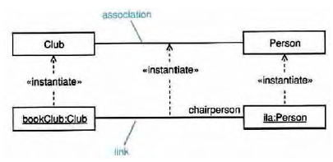
Association
Associations are semantic connections between classes.
If there is a link between two objects, there must be an association between the classes of those objects.
Links are instances of associations just as objects are instances of classes.
Association
Link

Slide 16
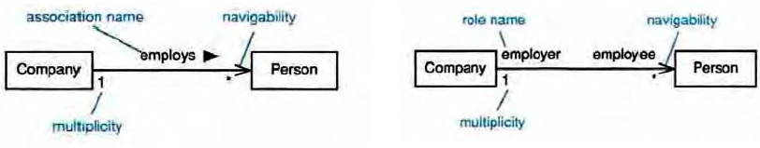
Association
Associations may optionally have the following:
Association name
may be prefixed or postfixed with a small black arrowhead to indicate the direction in which the name should be read;
should be a verb or verb phrase;
Role names
on one or both association ends;
should be a noun or noun phrase describing the semantics of the role;
Multiplicity
The number of objects that can participate in an instantiated relation
Navigability
Association name
navigability
role name
navigability
*
*
multiplicity
multiplicity

Slide 17
Association Multiplicity
Ask questions about the associations:
Can a company exist without any employee?
If yes, then the association is optional at the Employee end - zero or more (0..*)
If no, then it is not optional - one or more (1..*)
If it must have only one employee - exactly one (1)
What about the other end of the association?
Can an employee work for more than one company?
No. So the correct multiplicity is one.
Some examples of specifying multiplicity:
Optional (0 or 1) 0..1
Exactly one 1 = 1..1
Zero or more 0..* = *
One or more 1..*
A range of values 2..6
Company
1
0 .. *
Employee

Slide 18
Class associations
Multiplicity
A client has exactly one staffmember
as a contact person
Multiplicity
A staff member has zero or more clients on
His/her clientList
Name of the
association
:Client
:StaffMember
companyAddress
companyEmail
companyFax
companyName
companyTelephone
staffName
staff#
staffStartDate
1
liaises with
0..*
contact
person
ClientList
Direction
The “liaises with”
association should be
read in this direction
Role
The staffmember’s role in this association is as a contact person
Role
The clients’ role in this association is as a clientList

Slide 19
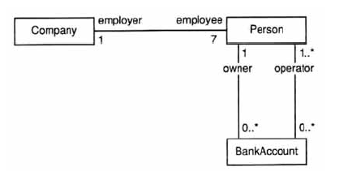
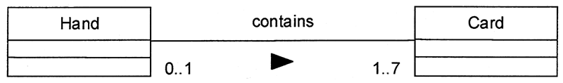
More Examples

Slide 20
Navigability / Visibility
Order
+ dateReceived: Date [0..1]
+ isPrepaid: Boolean [1]
+ lineItems: OrderLine [*] {ordered}
Date
0..1
*
Order
1
Boolean
+dateReceived
+isPrepaid
1
*
+lineItems {ordered}
OrderLine

Slide 21
Bidirectional Associations
Person
0..1
*
Car
Person
+ carsOwned: Car [*]
Car
+ Owner: Person [0..1]
Hard to implement correctly!

Slide 22
Generalization
Generalization is a relationship between a more general thing and a more specific thing:
the more specific thing is consistent in every way with the more general thing.
the substitutability principle states that you can substitute the more specific thing anywhere the more general thing is expected.

Slide 23
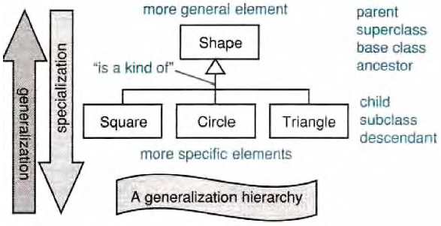
Generalization/Specialization
Generalization hierarchies may be created by generalizing from specific things or by specializing from general things.
More general element
Parent
Superclass
Ancestor
Base Class
“is a kind of”
Child
Subclass
Descendant
Leaf
More specific element

Slide 24
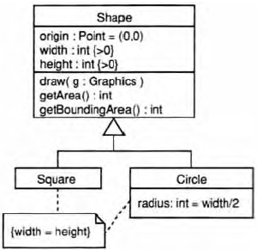
Inheritance
Class inheritance is implicit in a generalization relationship between classes.
Subclasses inherit attributes, associations, & operations from the superclass

Slide 25
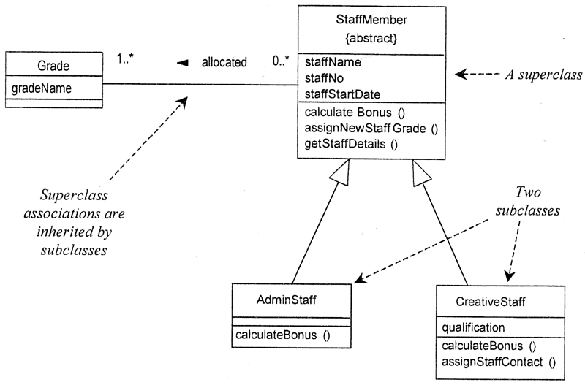
Inheritance
Notes:
A subclass may override an inherited aspect
e.g. AdminStaff & CreativeStaff have different methods for calculating bonuses
A Subclass may add new features
qualification is a new attribute in CreativeStaff
Superclasses may be declared {abstract}, meaning they have no instances
Implies that the subclasses cover all possibilities
e.g. there are no other staff than AdminStaff and CreativeStaff

Slide 26
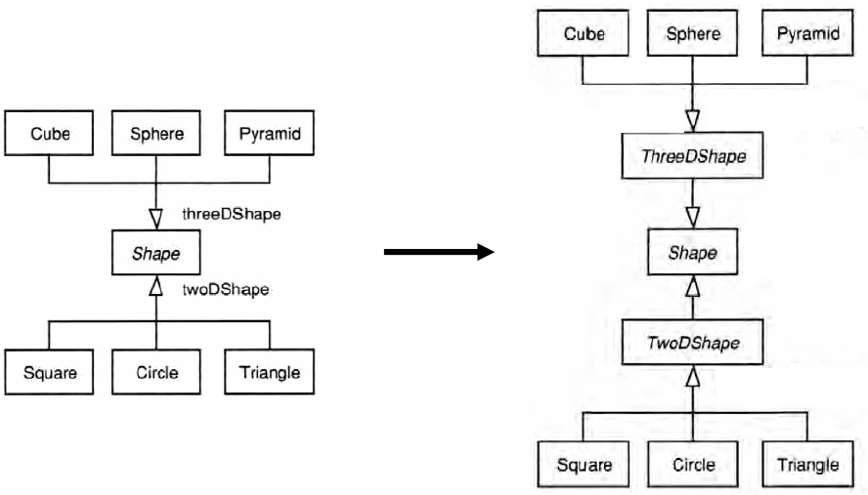
Generalization Sets: Implementation

Slide 27
Aggregation and Composition
Aggregation
This is the “Has-a” or “Whole/part” relationship
aggregation
Club
Member
*
*
:Car
:Train
0..1
:Person
0..1
0..*
driver
1
passengers
aggregation

Slide 28
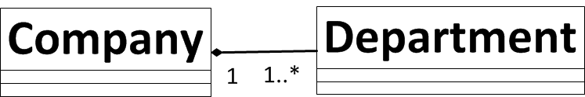
Aggregation and Composition
Aggregation
This is the “Has-a” or “Whole/part” relationship
Composition
Strong form of aggregation that implies ownership:
if the whole is removed from the model, so is the part.
the whole is responsible for the disposition of its parts
Note: Parts can be removed from the composite (where allowed) before the composite is deleted
Polygon
{ordered}
Point
centre
Circle
3..*
1
Note: No sharing - any instance of point can be part of a polygon or a circle, but not both (Why?)
28
28

Slide 29
Aggregation and Composition
1
:Engine
composition
:Locomotive
1..*
1
0..1
:Car
:Train
0..1
:Person
0..1
0..*
driver
1
passengers
aggregation

Slide 30
Modeling Exercise
Draw the UML class diagram which represents a file system – containing files and directories

Slide 31
Dependency
Dependencies are relationships in which a change to the supplier affects, or supplies information to, the client.
The client depends on the supplier in some way.
Dependencies are drawn as a dashed arrow from client to supplier.
Model
View
ViewController
Layout

Slide 32
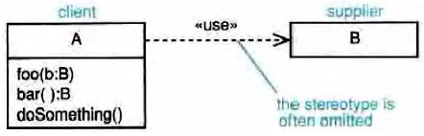
Usage Dependencies
«use»-the client makes use of the supplier in some way -this is the catch-all.
«call»-the client operation invokes the supplier operation.
«parameter»-the supplier is a parameter or return value from one of the client's operations.
«instantiate»-the client is an instance of the supplier.
client
Supplier
The stereotype is often omitted

Slide 33
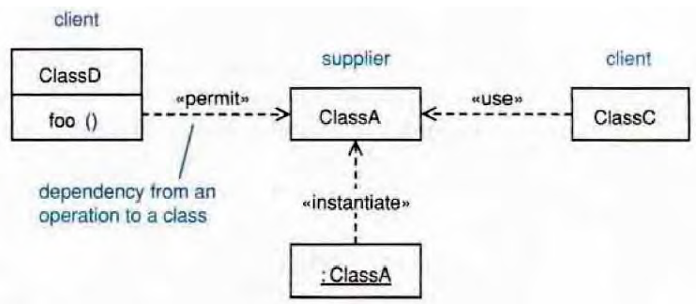
Dependencies: Example
client
Supplier
client
<<call>>
<<use>>
Dependency from an operation to a class
<<instantiate>>
Example Dependency types:
<<call>>
<<use>>
<<create>>
<<derive>>
<<instantiate>>
<<permit>>
<<realize>>
<<refine>>
<<substitute>>
<<parameter>>

Slide 34
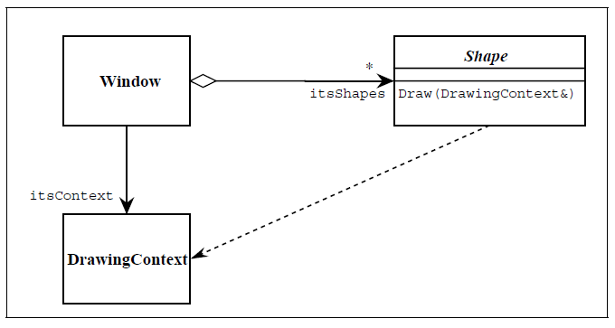
Dependency
Notes:
Figure 7 shows a dashed arrow between the Shape class and the DrawingContext class. This is the dependency relationship. In Booch94 this was called a ‘using’ relationship. This relationship simply means that Shape somehow depends upon DrawingContext. In C++ this almost always results in a #include.

Slide 35
Interfaces
<<interface>>
Collection
equals
add
Order
LineItems [*]
<<interface>>
List
get
<<realizes>>
ArrayList
get
add
<<requires>>
Collection
Order
LineItems [*]
List
ArrayList
Notes:
There are classes that have nothing but pure virtual (abstract) functions. In Java such entities are not classes
at all; they are a special language element called an interface. UML has followed the Java
example and has created some special syntactic elements for such entities.

Slide 36
Annotation
Comments
-- can be used to add comments within a class description
Notes
Constraint Rules
Any further constraints {in curly braces}
e.g. {time limit: length must not be more than three months}
Date Range
Start: Date
End: Date
/length: integer
{length = start - end}

Slide 37
What UML class diagrams can show
Division of Responsibility
Operations that objects are responsible for providing
Subclassing
Inheritance, generalization
Navigability / Visibility
When objects need to know about other objects to call their operations
Aggregation / Composition
When objects are part of other objects
Dependencies
When changing the design of a class will affect other classes
Interfaces
Used to reduce coupling between objects

Slide 38
Good Analysis Classes
What makes a good analysis class?
Its name reflects its intent.
It is a crisp abstraction that models one specific element of the problem domain.
It maps to a clearly identifiable feature of the problem domain.
It has a small, well-defined set of responsibilities:
a responsibility is a contract or obligation that a class has to its clients;
a responsibility is a semantically cohesive set of operations;
there should only be about three to five responsibilities per class.
It has high cohesion – all features of the class should help to realize its intent.
It has low coupling – a class should only collaborate with a small number of other classes to realize its intent.

Slide 39
Bad Analysis Classes
What makes a bad analysis class?
A functoid- a class with only one operation.
A stand-alone class (island( -each class should be associated with a small number of other classes with which it collaborates to deliver the desired benefit.
An omnipotent class -a class that does everything (classes with "system" or "controller" in their name may need closer scrutiny).
A class with a deep inheritance tree -in the real world inheritance trees tend to be shallow.
A class with low cohesion.
A class with high coupling.
Many very small classes in a model – merging should be considered.
Few but large classes in a model – decomposition should be considered.

Slide 40
Class Identification Techniques
Noun/Verb Analysis (Grammatical Parsing)
CRC Analysis
Use-Case-Based Analysis
Real-World Analysis

Slide 41
Noun/verb analysis (Grammatical Parsing)
1.Collect as much relevant information about the problem domain as possible; suitable sources of information are:
The requirements model
The use case model
The project glossary
Any other document (architecture, vision documents, etc.)
2.Analyze the documentation:
Look for nouns or noun phrases -these are candidate classes or attributes.
Look for verbs or verb phrases -these are candidate responsibilities or operations.
3.Make a tentative allocation of the attributes and responsibilities to the classes.

Slide 42
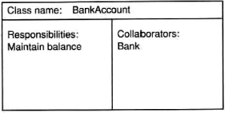
CRC Analysis –CRC Cards
CRC – Class, Responsibilities, and Collaborators
Important things in the problem domain are written on CRC Cards. Each Card has three compartments:
Class – contains the name of the class
Responsibilities – contains a list of the responsibilities of that class (the functions it performs and even the information it is responsible to keep and provide)
Collaborators – contains a list of other classes with which this class collaborates in order to fulfill the responsibilities

Slide 43
CRC Analysis Procedure – Phase 1
The participants are 00 analysts, .stakeholders, and domain experts.
Phase 1: Brainstorm – gather the information:
1. Explain that this is a true brainstorm.
1. All ideas are accepted as good ideas.
2. Ideas are recorded but not debated.
2. Ask the team members to name the "things" that operate in their business domain -for example, customer, product.
1. Write each thing on a sticky note; it is a candidate class, or attribute of a class.
2. Stick the note on a wall or whiteboard.
3. Ask the team to state responsibilities that those things might have; record these in the responsibilities compartment of the note.
4. Working with the team, identify classes that might work together; record collaborators in the collaborators compartment of the note.
This is an iterative work !!!!

Slide 44
CRC Analysis Procedure – Phase 2
The participants are OO analysts and domain experts.
Phase 2: Decide which sticky notes should become classes and which should become attributes:
Analysis classes must represent a crisp abstraction in the problem domain. Certain sticky notes will represent key business concepts and clearly need to become classes.

Slide 45
Real-World Analysis
Explore the real world for classes. Candidates: physical objects, paperwork, interfaces to the outside world, and conceptual entities;
Physical objects: Things such as aircraft, people, and hotels may all indicate classes.
Paperwork: Things like invoices, orders, and bankbooks may all indicate possible classes; beware of paperwork supporting the redundant business processes that the new system might be trying to replace.
Known interfaces to the outside world: Things such as screens, keyboards, peripherals, and other systems can be a source of candidate classes, especially for embedded systems.
Conceptual entities: Things that are crucial to the operation of the business but are not manifest as concrete things; such as enrollment, educational program, and alarm condition.

Slide 46
Outline
2
Why Modeling
Introduction to UML
History
Super Structure
UML Class Diagram
Notation
Classes vs. Objects
Relationships
UML Activity Diagram
Notation
Partitioning
Action / Control / Object Nodes

Slide 47
UML Activity Diagrams

Slide 48
UML2 Diagram Super Structure
Structure Diagram: uses objects, attributes, operations and relationships to emphasize the static structure
Behavior Diagram: shows the collaboration among objects and changes to the internal states of objects to emphasize dynamic behaviour
48/7

Slide 49
Activity Diagrams
Activity diagrams are OO flowcharts:
used for modeling all types of processes;
can be attached to any modeling element to capture its behavior;
a good activity diagram communicates one specific aspect of a system's behavior;

Slide 50
Activities
Activities are networks of nodes connected by edges.
Categories of nodes:
Action nodes – atomic units of work within the activity;
Control nodes – control the flow through the activity;
Object nodes – represent objects used in the activity.
Categories of edges:
Control flows – represent the flow of control though the activity;
Object flows – represent the flow of objects through the activity.
Activities can have preconditions and postconditions.

Slide 51
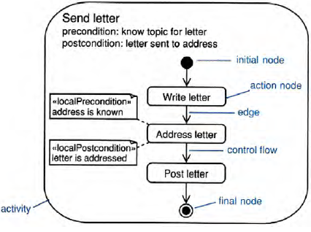
Activities: Example

Slide 52
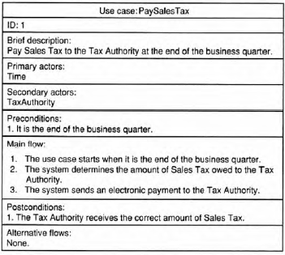
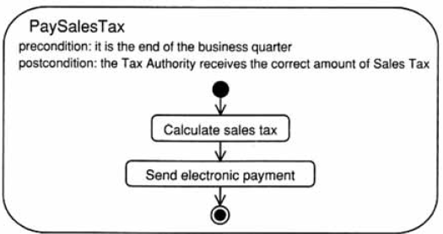
Activity Diagrams: Use Case Modeling

Slide 53
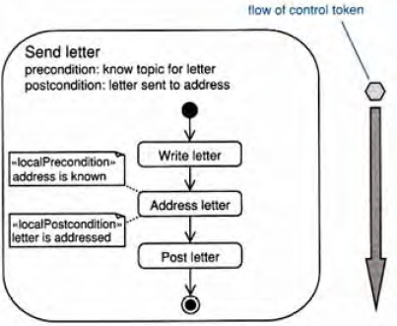
Activities: Tokens
Tokens flow around the network and can represent:
the flow of control;
an object;
some data.
Tokens move from a source node to a target node across an edge depending on:
source node postconditions;
edge guard conditions;
target preconditions.
The state of executing system may be represented at any point in time by the disposition of its token. However not every action execution or token flow constitutes a notable change in the state of system
Notes:
Petri-nets

Slide 54
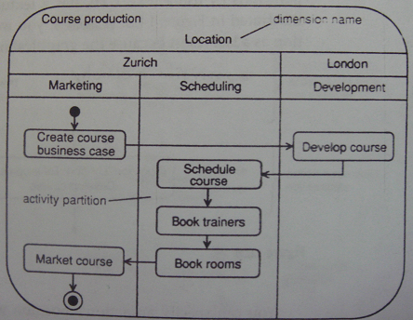
Activity Partitions
Activity partitions – a high-level grouping of related actions.
Partitions form a hierarchy rooted in a dimension.
Dimension Name
Activity Partition

Slide 55
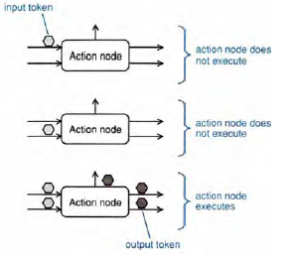
Action Nodes
Execute when there is a token simultaneously on each of their input edges AND their preconditions are satisfied.
After execution, action nodes offer tokens simultaneously on all output edges whose postconditionsare satisfied:

Slide 56
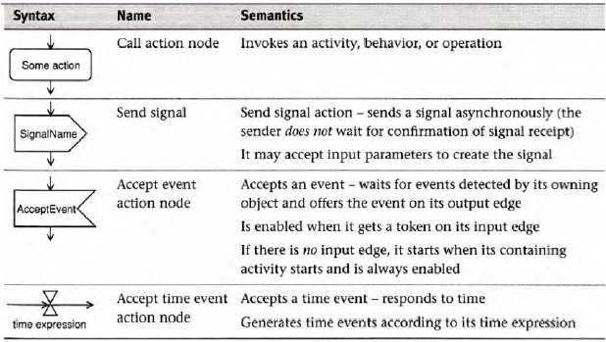
Action Nodes: Types

Slide 57
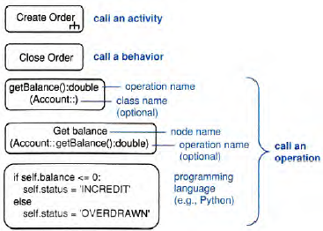
Action Nodes: Call
Call action node:
call an activity - use the rake symbol;
call a behavior;
call an operation.

Slide 58
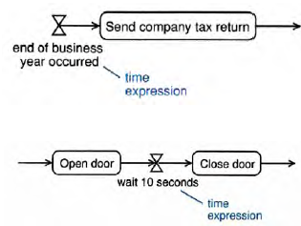
Action Nodes: Accept Time Event
Accept time event action node -executes when its time expression is true:
an event in time (e.g., end of business year);
a point in time (e.g., on 11/03/1960);
a duration (e.g., wait 10 seconds).

Slide 59
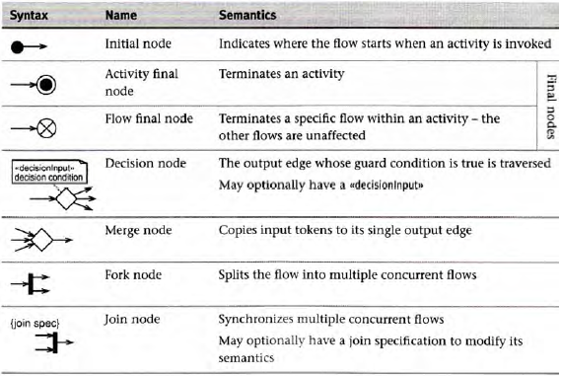
Control Nodes

Slide 60
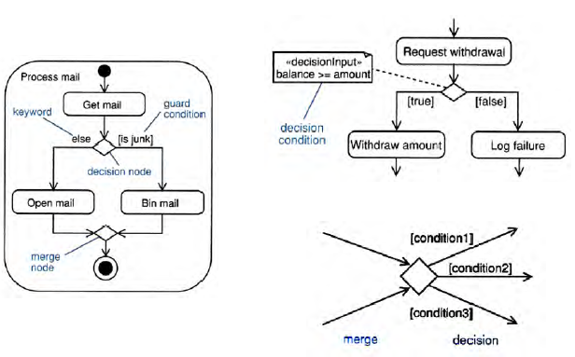
Control Nodes: Decision and Merge

Slide 61
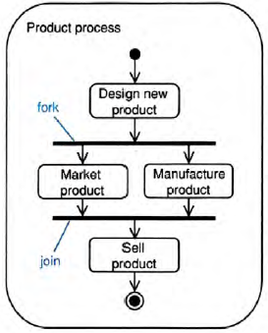
Control Nodes: Fork and Join
Fork : Generating Parallel flows
fork
Join : Synchronizing Parallel flows
++All the incoming flows must deliver a token
Join

Slide 62
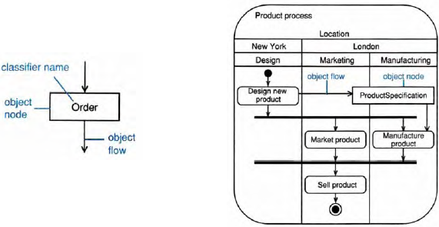
Object Nodes
Object nodes represent instances of a classifier.
Object flows represent the movement of objects.
Classifier name
Object node
Object flow

Slide 63
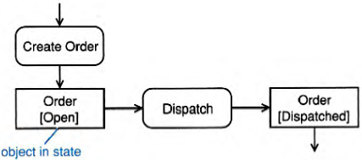
Object Nodes: States
Object nodes can represent objects in a particular state:
Must be consistent with state machine.

Slide 64
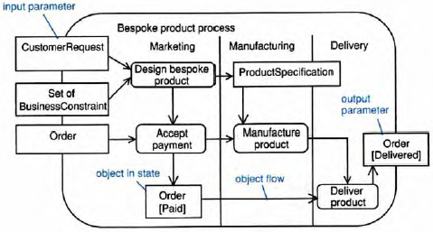
Object Nodes: Activity Parameters
Activity parameters are object nodes input to or output from an activity:
drawn overlapping the activity frame;
input parameters have one or more output edges into the activity;
output parameters have one or more input edges out of the activity.
Input parameter
Output parameter
Object in state
object flow

Slide 65
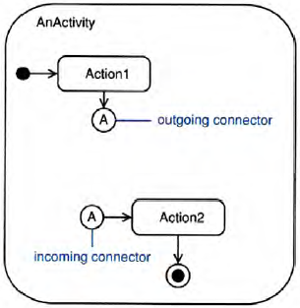
Connectors

Slide 66
Why Modeling?

Slide 67
Resources
Arlow, J., Neustadt, I., UML 2 and the Unified Process: Practical Object-Oriented Analysis and Design, 2ndEd. Addison-Wesley, 2005.
Fowler, M., UML Distilled (3rd Edition), Addison-Wesley, 2004
Steve Easterbrook, Lecture Slides of Introduction to Modeling and UML

